Slide 1
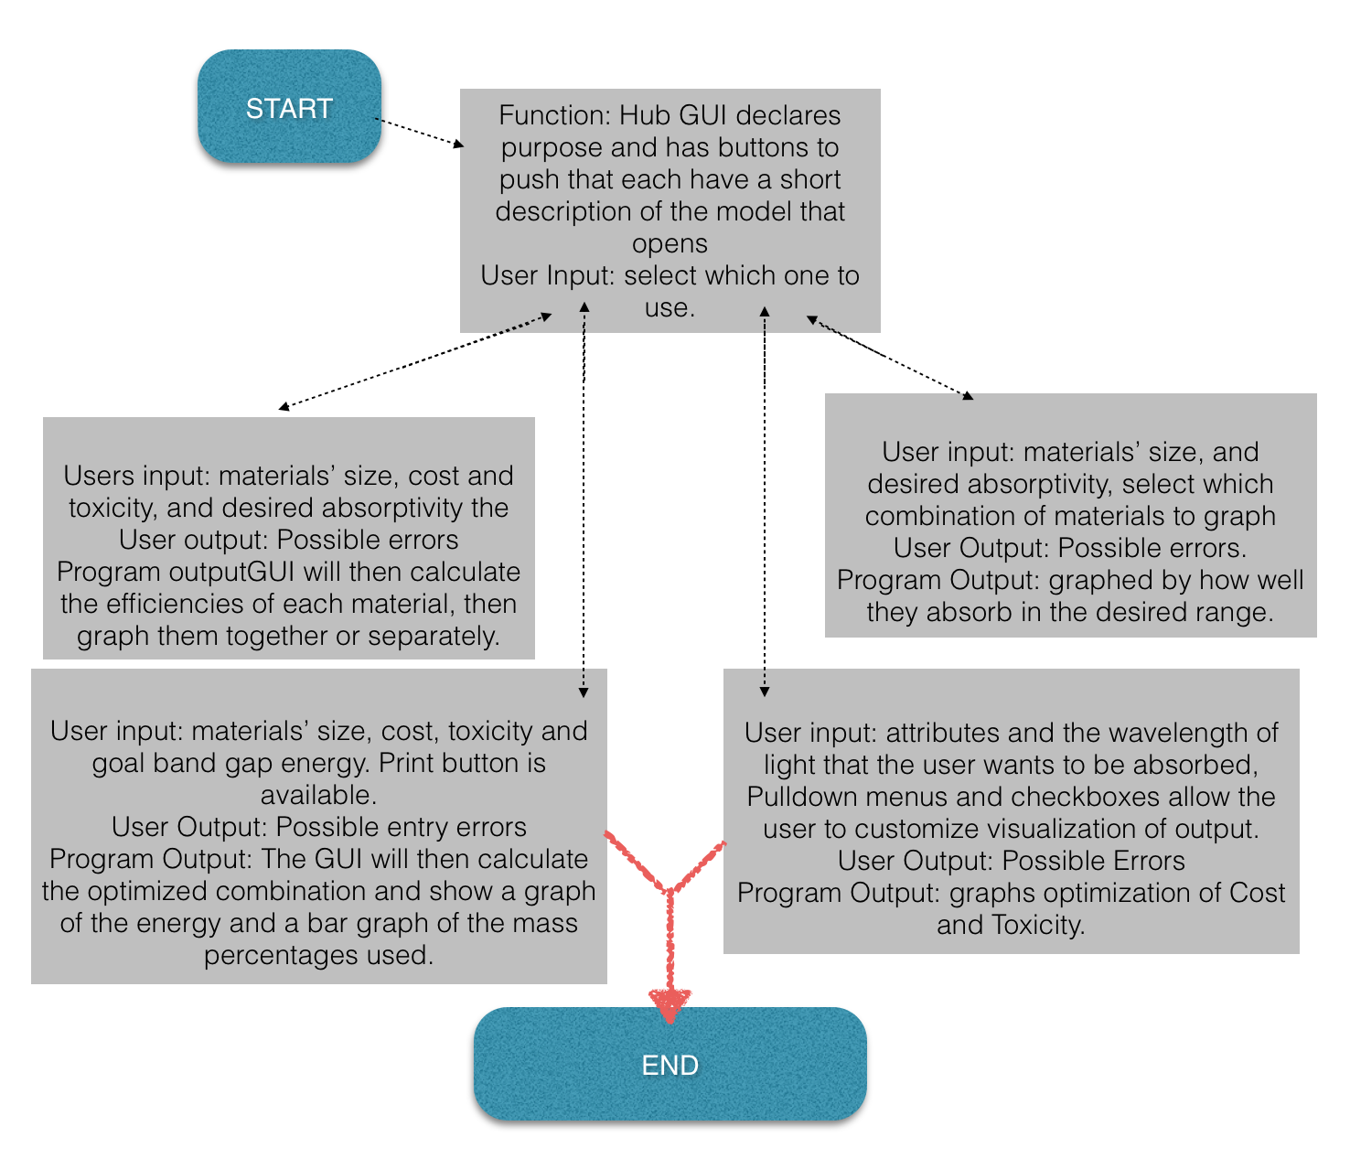

Citations
‘Second’ GUI:
‘First’ GUI:
‘Third’ GUI:
‘Fourth’ GUI:
Should not spend more than 1-2 minutes talking on this slide
Notes:
Discuss for each GUI screen:
Programmatic inputs/outputs
User inputs/outputs
Each teammate describe what his/her model/simulation will do (one sentence preview)

Slide 2
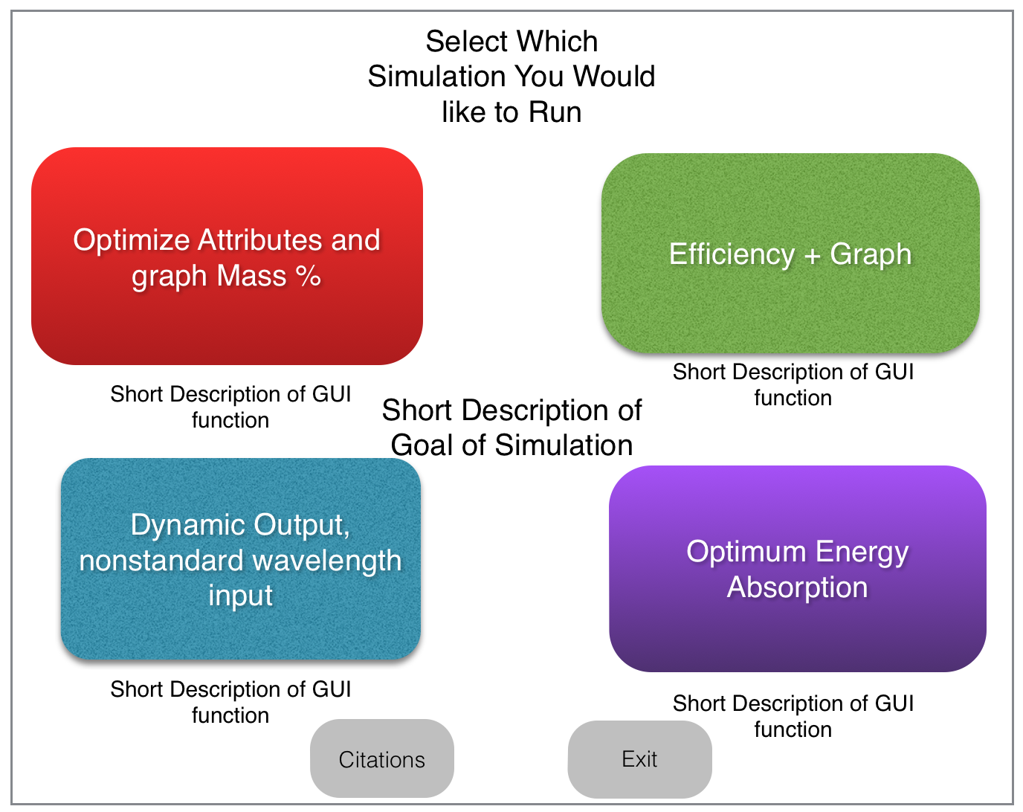
Citations

